Slide 1

FitStack
A Unified Relational Database for Training, Nutrition & Progress Tracking
DBMS Zeroth Review — Course 22AIE303
Name:
Mamidala Som Praneeth Babu CB.SC.U4AIE24029
Charith Dasari CB.SC.U4AIE24014

Slide 2
What I'll Cover
1.
Problem statement and objectives
2.
Users / actors and the use case diagram
3.
ER diagram and relational schema
4.
Functional modules and how they interact
5.
DBMS concepts used, mapped to actual features
6.
Sample database operations (CRUD, joins, aggregates)
7.
Live verification on the deployed database
8.
Work completed so far, and what's planned next
FitStack — DBMS Zeroth Review
2

Slide 3
Problem Statement
Serious lifters currently need two or three separate apps — one for workout logging, one for calorie/macro tracking, one for body-weight tracking — none of which share a data model.
•
App fragmentation — Training, nutrition, and body-composition data live in disconnected silos (e.g. Hevy, MyFitnessPal, a separate tracker).
•
Static targets — Calorie/macro targets are set once from a formula and never adapt to a user's actual logged weight-trend and intake.
•
No cross-domain insight — A stalled lift and an under-eating week look unrelated even when one causes the other, because no single schema links them.
•
No unified schema — Nothing today links workout volume, calorie intake, and body metrics in one queryable relational database.
Core insight: fitness data is inherently relational; existing apps treat it as flat, disconnected records. FitStack solves this with one normalized PostgreSQL schema spanning all three domains under one user account.
FitStack — DBMS Zeroth Review
3

Slide 4
Objectives
1
Design a fully normalized (3NF) relational schema spanning training, nutrition, and progress domains, with correct FK relationships and supporting indexes.
2
Enforce per-user data isolation structurally at the database layer (Postgres Row-Level Security) rather than in application code, so no code path can bypass it.
3
Implement an adaptive TDEE (calorie expenditure) estimator computed from a user's real logged weight-trend and intake data, replacing a static BMR formula.
4
Implement automatic personal-record and training-plateau detection from raw workout set-log history.
5
Ship a controlled-access pilot model — signup plus manual admin approval — suitable for a small trusted user group.
6
Verify the schema, constraints, and access-control rules end-to-end against a live deployed database, not just in isolation.
FitStack — DBMS Zeroth Review
4

Slide 5
Users / Actors
Actor | Role
Trainee (end user) | Registers, gets approved, logs workouts / food / weight, views the dashboard, manages routines and custom exercises / foods. Covers lifting-focused, nutrition-focused, and progress-focused usage — all against the same account and schema.
Admin (approver) | Reviews new signups and sets profiles.approved = true before an account can write training/nutrition/progress data. Not yet a formal database role/flag — currently whoever has direct project access. Stated as a known, deliberate limitation at this stage.
System (seed / library data) | Not a human actor — library exercises/foods rows (is_custom = false, created_by = NULL) are owned by no user and visible to everyone, distinct from user-created custom content.
FitStack — DBMS Zeroth Review
5

Slide 6
Use Case Diagram
Chosen over a Class Diagram — the ER and Relational Schema slides already cover the data model; this shows how the two actors use the system.
FitStack System
Register
Log Food Entry
(includes: seed baseline target & body metric)
(extends: create custom food)
Log In
Log Body Metric
Log Workout Set
View Dashboard
(includes: detect personal record)
(includes: weekly volume, plateaus, macro suggestion)
Trainee
Complete Workout Session
Recompute Nutrition Target
Admin
Create / Edit Routine
(includes: estimate TDEE)
Approve Trainee Account
FitStack — DBMS Zeroth Review
6

Slide 7
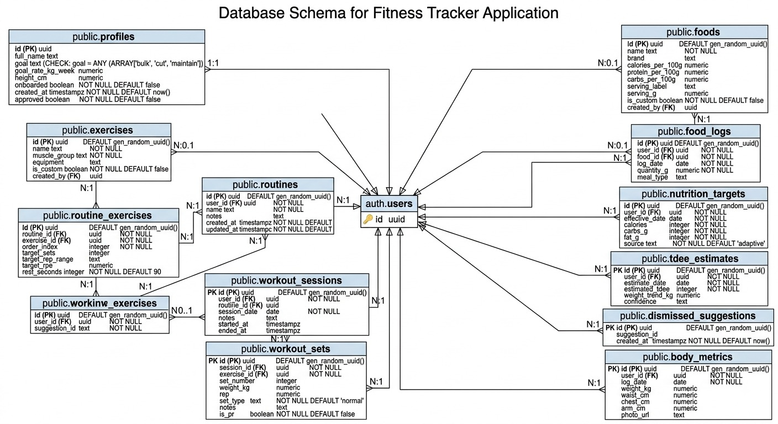
ER Diagram
[ paste ER diagram image here ]
Image generated by Gemini , Verified by Precentors (Praneeth and Charith)
FitStack — DBMS Zeroth Review
7

Slide 8
ER Diagram — Constraints
Verified directly against the live database, not just the migration files.
Type | Applied to | Rule
CHECK | profiles.goal | goal IN ('bulk', 'cut', 'maintain')
CHECK | profiles | NOT onboarded OR (goal, goal_rate_kg_week, height_cm are all NOT NULL)
UNIQUE | body_metrics | UNIQUE (user_id, log_date) — one weigh-in per user per day
ON DELETE CASCADE | workout_sets → workout_sessions routine_exercises → routines all tables → auth.users | Deleting the parent row removes its children automatically
ON DELETE SET NULL | workout_sessions.routine_id → routines.id | Deleting a routine detaches past sessions instead of deleting them
FitStack — DBMS Zeroth Review
8

Slide 9
Relational Schema
profiles(user_id_PK, name, goal, height,
onboarding_status, approval_status)
exercises(exercise_id_PK, name, muscle_group,
equipment, is_user_added, created_by_FK)
routines(routine_id_PK, user_id_FK, name, notes)
routine_exercises(routine_exercise_id_PK,
routine_id_FK, exercise_id_FK, order,
target_sets, target_reps)
workout_sessions(session_id_PK, user_id_FK,
routine_id_FK, date, start_time, end_time,
notes)
workout_sets(set_id_PK, session_id_FK,
exercise_id_FK, weight, reps, is_pr)
foods(food_id_PK, user_id_FK, name,
calories_per_100g, protein, carbs, fat,
is_custom)
food_logs(food_log_id_PK, user_id_FK,
food_id_FK, quantity, meal_type, date)
nutrition_targets(target_id_PK, user_id_FK,
date, calorie_target, protein_target,
carbs_target, fat_target, source)
tdee_estimates(tdee_id_PK, user_id_FK, date,
estimated_tdee)
dismissed_suggestions(dismissal_id_PK,
user_id_FK, suggestion_type, dismissed_at)
body_metrics(metric_id_PK, user_id_FK, date,
weight, waist, chest, arm, photo_url)
FitStack — DBMS Zeroth Review
9

Slide 10
Functional Blocks / Modules
Auth & Access Control
Signup, login, session, approval gate
Training
Nutrition
Progress
Exercises, routines, sessions, sets
Food library, logging, targets
Body metrics, trend
Adaptive Intelligence Engine
TDEE estimation, PR / plateau detection, macro suggestions — computed in the application layer, not stored SQL logic
Dashboard Aggregation
Cross-module summary view, reads from all four modules
Database layer: 12 tables, RLS enabled on every one, CHECK/UNIQUE constraints, composite B-tree indexes. No custom backend server — the frontend queries Postgres directly via Supabase's auto-generated REST layer (PostgREST).
FitStack — DBMS Zeroth Review
10

Slide 11
DBMS Concepts Used — Data Integrity
Project Function | DBMS Concept
Linking every child table back to its owner | Primary Key / Foreign Key, referential integrity
Deleting a session removes its sets; deleting a routine detaches (not deletes) past sessions | ON DELETE CASCADE / ON DELETE SET NULL
Goal restricted to bulk/cut/maintain; onboarding fields required together | CHECK constraints
One weigh-in per user per day | UNIQUE constraint
food_logs stores a food_id + quantity, not duplicated macro data | Normalization (3NF)
FitStack — DBMS Zeroth Review
11

Slide 12
DBMS Concepts Used — Access & Performance
Project Function | DBMS Concept
Per-user data isolation on every table, without relying on app code | Row-Level Security (USING / WITH CHECK, auth.uid())
Blocking writes from unapproved accounts on log/progress tables | RLS policy composed with an EXISTS subquery against profiles.approved
Auto-creating a profile row the instant a user signs up | Trigger (handle_new_user() on auth.users AFTER INSERT)
Fast dashboard / date-range lookups | Composite B-tree indexes, e.g. (user_id, log_date)
Sessions-this-week count, weekly volume | Aggregate functions (COUNT, SUM) with GROUP BY
Attaching food facts to a log entry, exercise details to a routine | JOIN
Each individual INSERT / UPDATE / DELETE | Statement-level atomicity (Postgres). No multi-statement app transaction yet — an honest scope gap, planned for Review 2
FitStack — DBMS Zeroth Review
12

Slide 13
Sample Database Operations
What the four basic operations actually do inside FitStack — no raw SQL, just what happens.
CREATE
INSERT
Setting up a new table when a feature is added. body_metrics, for example, was created to hold one weigh-in per user per day, linked to that user's account, with the one-per-day rule enforced automatically.
Adding new data as the user acts. When someone logs a set at the gym, a new row goes into workout_sets with the weight, reps, and which exercise it was, tied to that workout session.
UPDATE
DELETE
Changing existing data. When an admin approves a new signup, the matching row in profiles is updated so approved flips from false to true — unlocking the rest of the app for that user.
Removing data. If a user logged a set by mistake, that row is deleted from workout_sets — and if a whole session is deleted, its sets are removed automatically with it.
FitStack — DBMS Zeroth Review
13

Slide 14
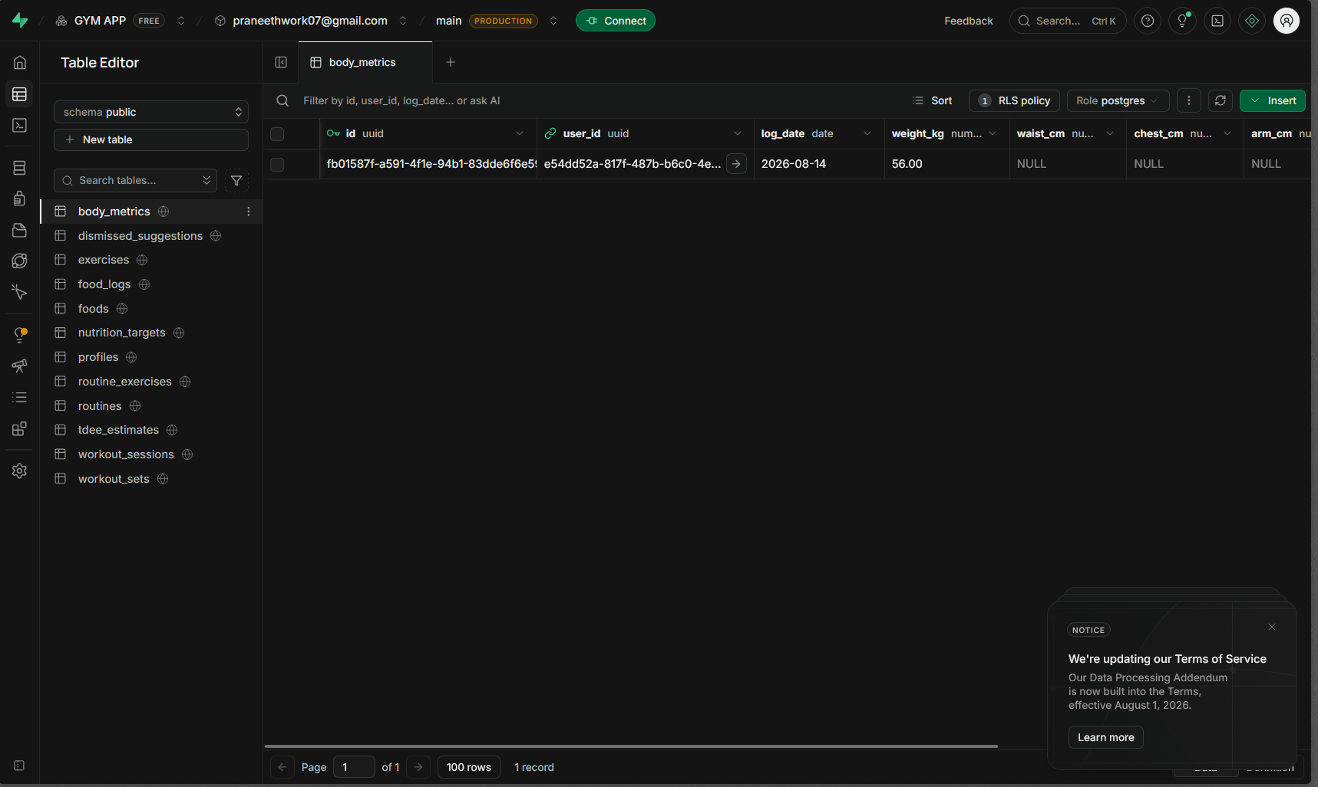
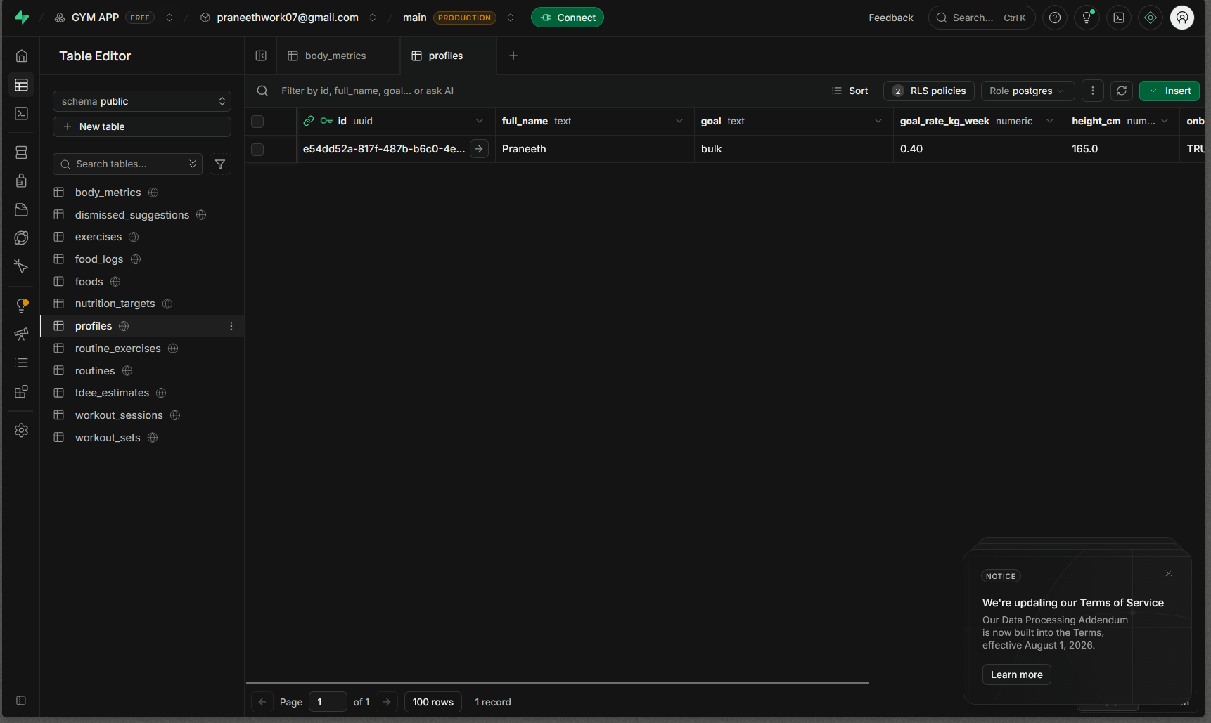
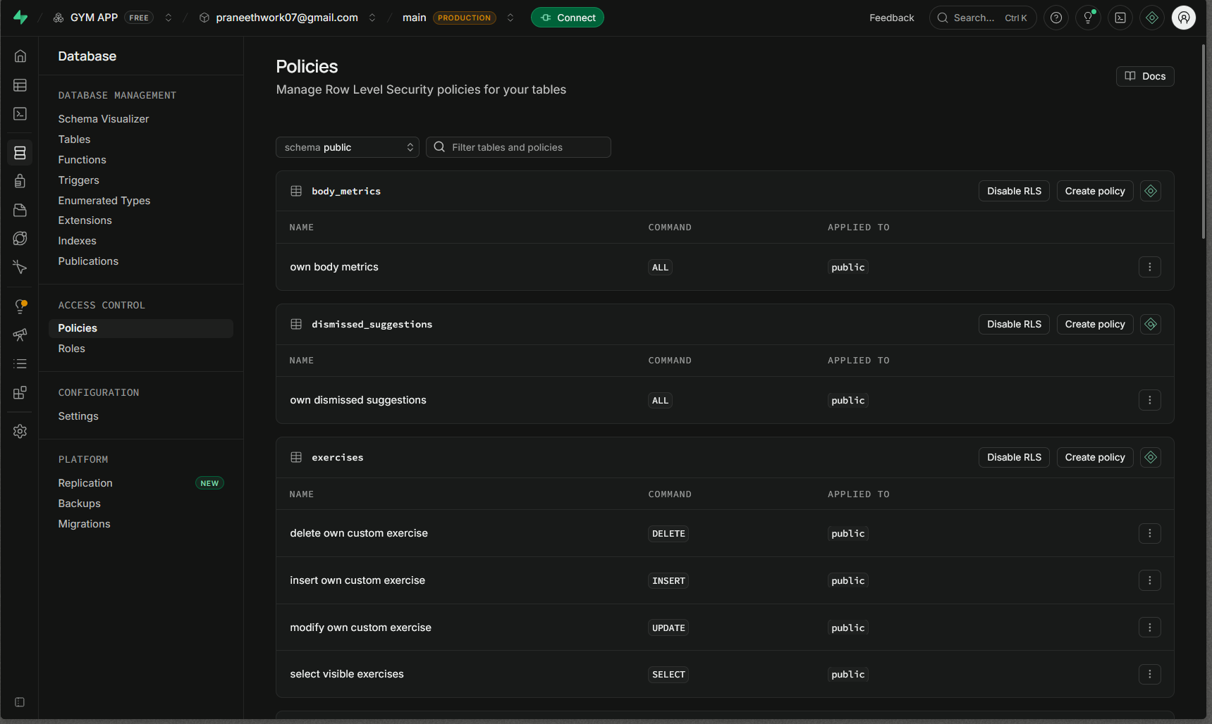
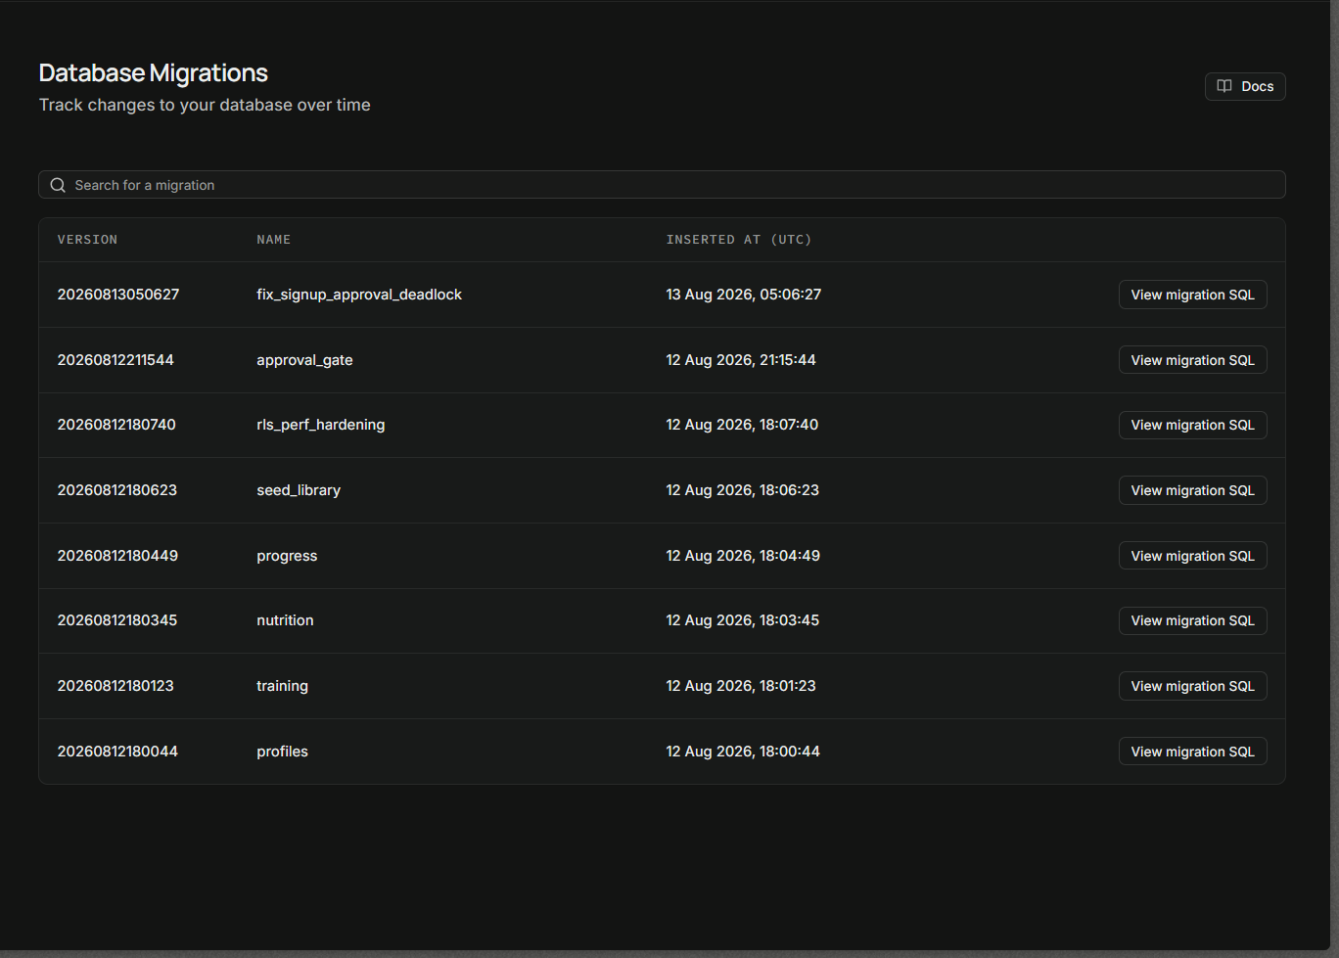
Live Verification — Supabase
Every constraint, policy, and index below was re-checked directly against the live database this session, not assumed from notes.
Table Editor — body_metrics, live row, RLS policy active
Table Editor — profiles, with the approved flag
Database → Policies — RLS enabled per table
Database → Migrations — version history
FitStack — DBMS Zeroth Review
14

Slide 15
Work Completed & Initial Output
Core schema and access control are built and verified — not the whole product.
•
Full 12-table relational schema designed and applied to a live Supabase/Postgres database via 8 sequential, version-controlled migrations.
•
Row-Level Security enabled and policy-protected on every table — every constraint, index, trigger, and policy re-verified directly against the live database this session.
•
Authentication (signup, login, session persistence) on Supabase Auth, with a working manual-approval access gate.
•
Application-layer service modules built for all four domains (training, nutrition, progress, dashboard).
•
Adaptive TDEE estimator and PR / plateau detection logic implemented (EMA smoothing, Epley e1RM formula).
•
One access-control defect found and fixed via direct testing: an RLS policy blocking new users from writing their own onboarding data, corrected in a dedicated migration and confirmed live.
FitStack — DBMS Zeroth Review
15

Slide 16
Future Work / Conclusion
This isn't just a schema problem. Say someone does Leg Press and logs 30kg, 40kg, 50kg across three sets — we already capture that. But everyone trains differently: push/pull/legs, upper/lower, straight sets, training to failure — and people switch formats every few weeks. Before Review 2, we want a solid way to track progress across all of that, not just log numbers.
Planned before Review 2
•
Set-by-set progress views — e.g. compare Set 1 of Leg Press over the last 2 months, not just total volume. The data is already in workout_sets; this is a feature to build on top of it, not a schema change.
•
Let a routine carry a training style tag (push/pull/legs, failure-based, etc.) so progress is compared fairly within the same style, not mixed across different formats.
•
Preserve old routine structures when a user redesigns their split, instead of overwriting them — so switching formats monthly doesn't erase history.
•
Deploy the frontend to a public URL and onboard a small pilot group, to see how real, varied training styles actually stress this.
•
•
Conclusion
FitStack already stores workout, nutrition, and progress data under one schema instead of three separate apps, with access rules enforced by the database itself. The next challenge isn't more tables — it's making the schema flexible enough for how differently everyone actually trains.
FitStack — DBMS Zeroth Review
16

Slide 17
Thank You
Ashwathy Mam — DBMS (22AIE303)
FitStack — DBMS Zeroth Review
17

